Slide 1
MySQL Installation

Slide 2
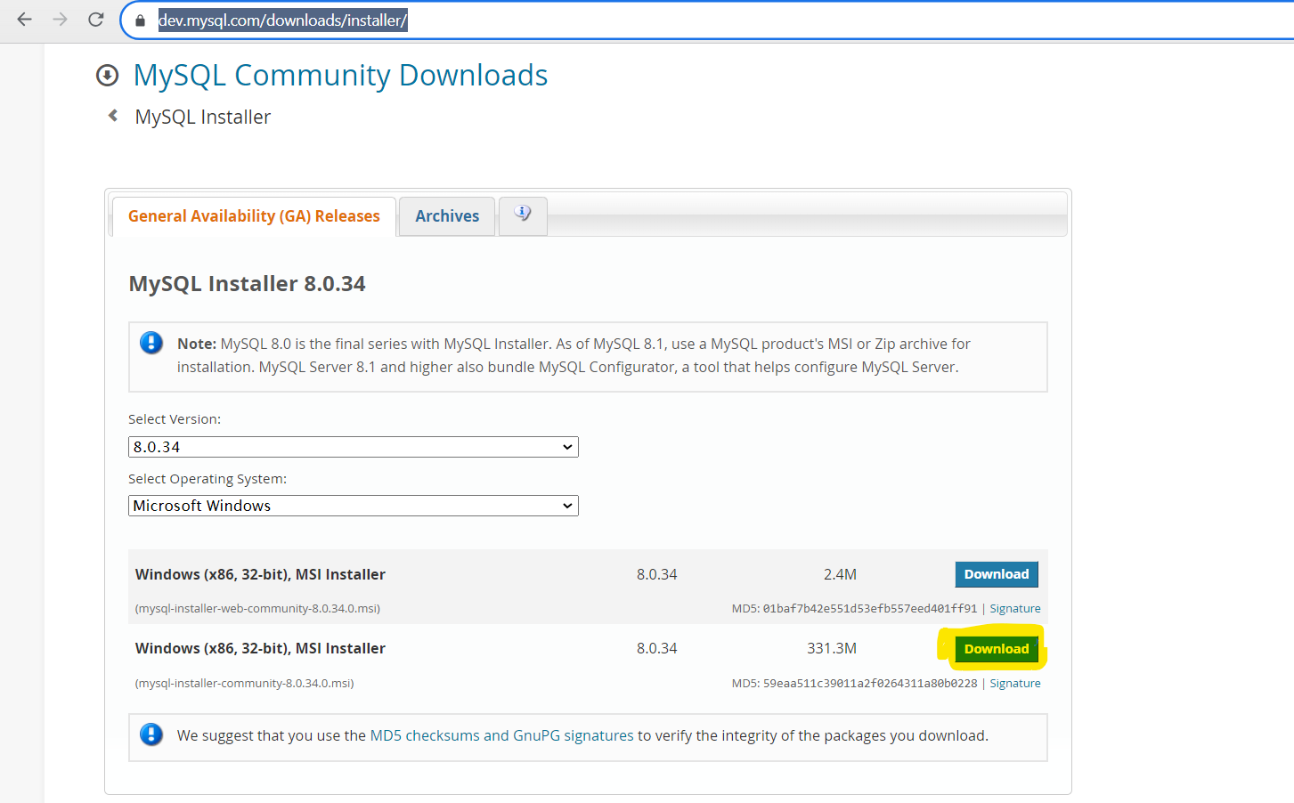
Steps To Install Mysql
1. Go to browser and execute the below link. And click on the highlighted download.
https://dev.mysql.com/downloads/installer/

Slide 3
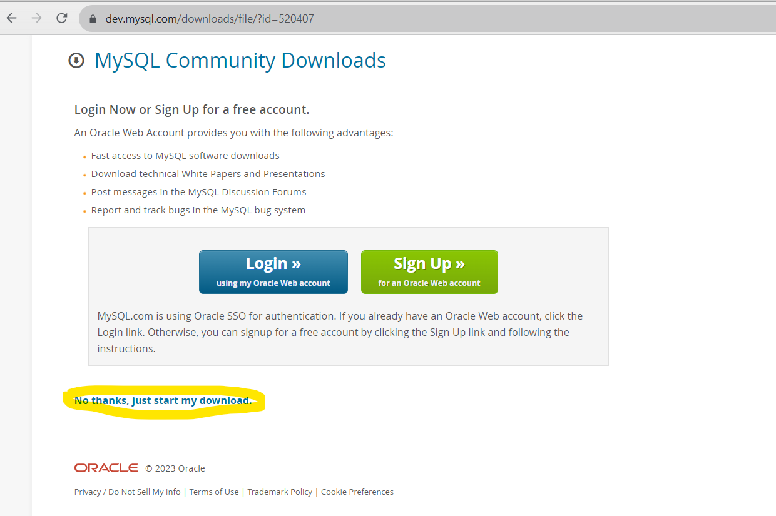
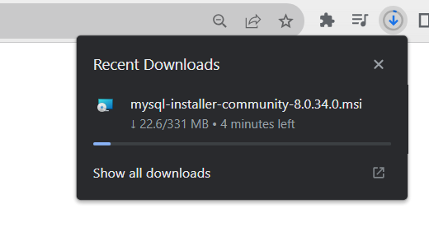
Click on “No thanks, just start my download”. It will start downloading.

Slide 4
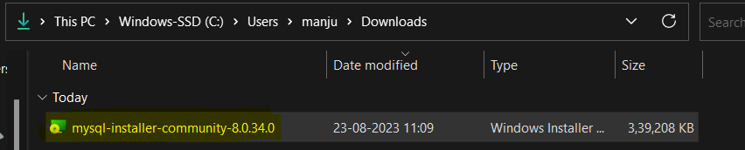
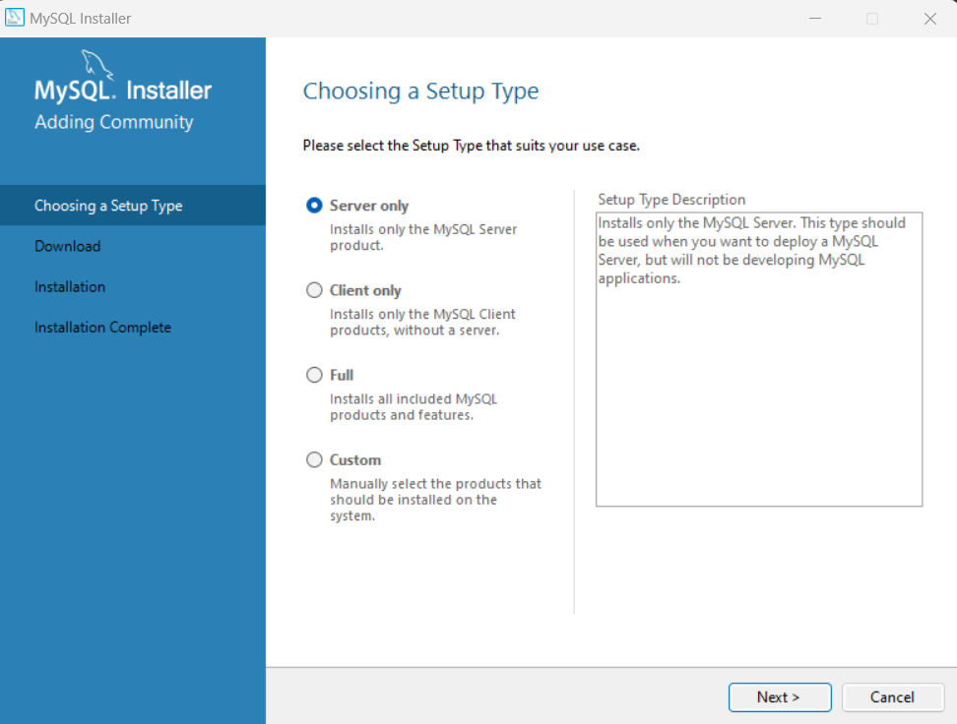
Once the download complete.
Double click on it and it will start the set up.

Slide 5
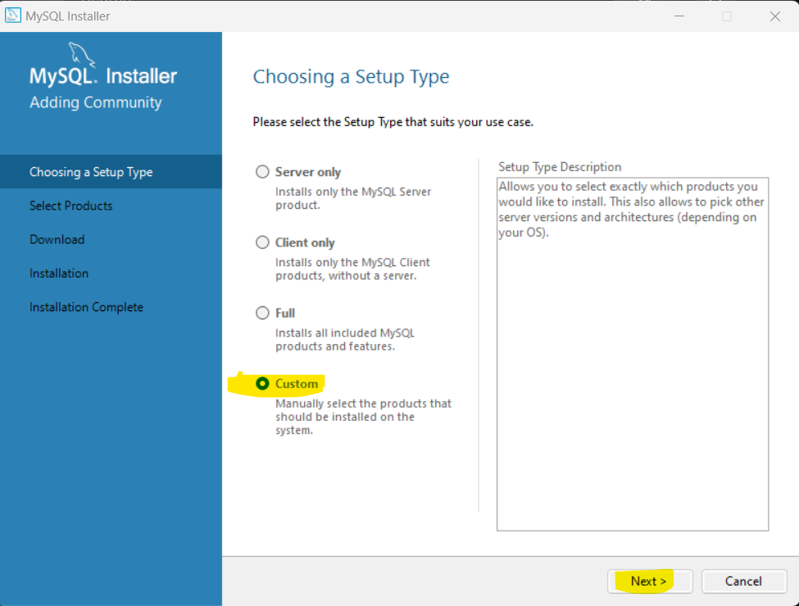

Slide 6
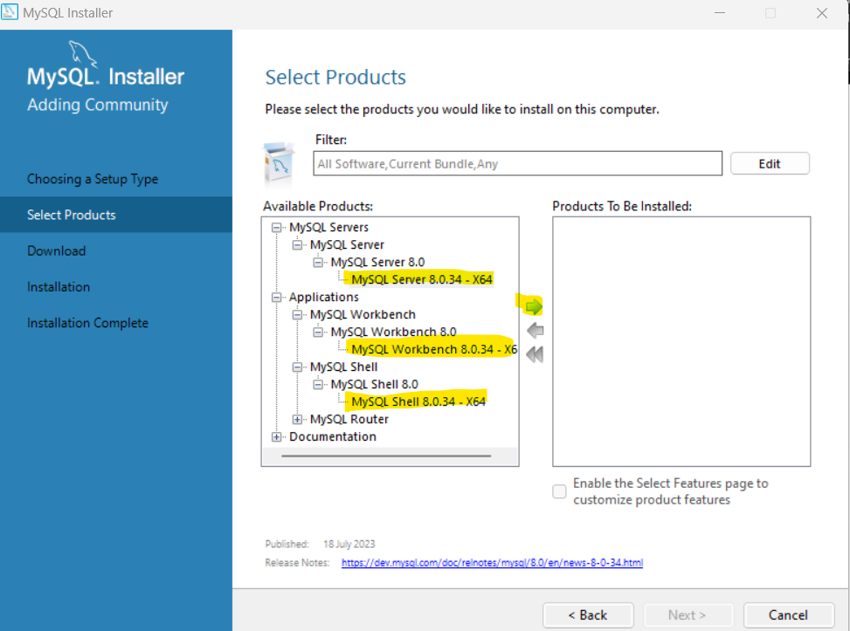
Select one by one and click on the arrow to move to the “Products To Be Installed”

Slide 7
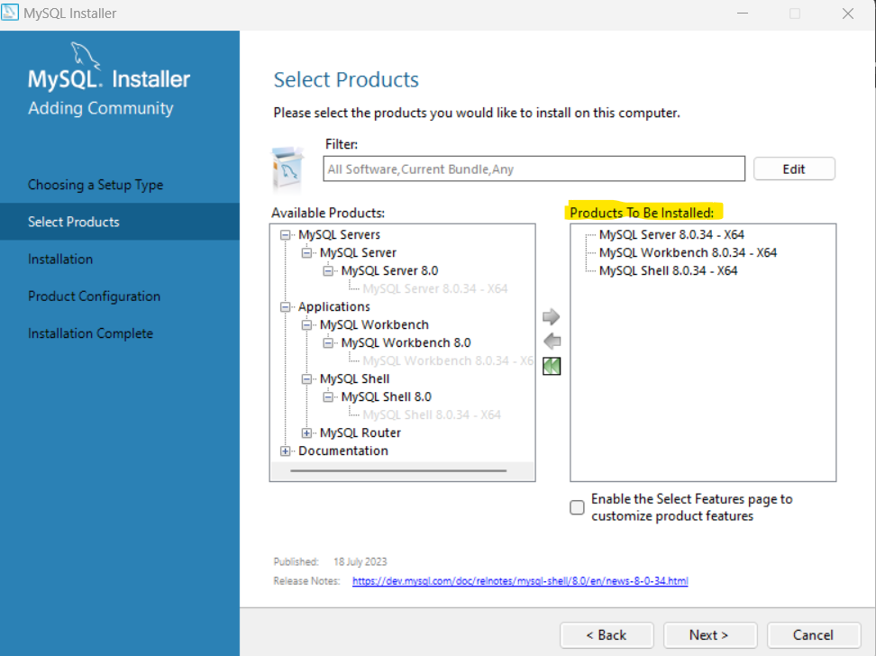

Slide 8
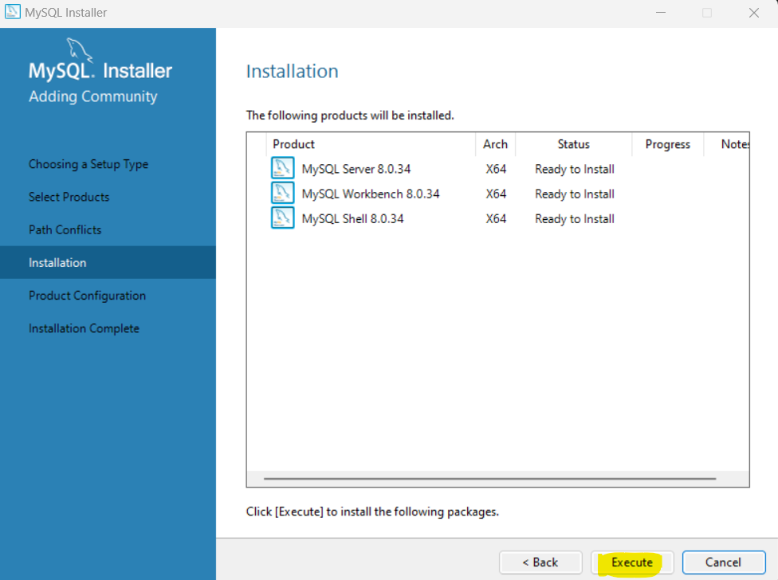

Slide 9
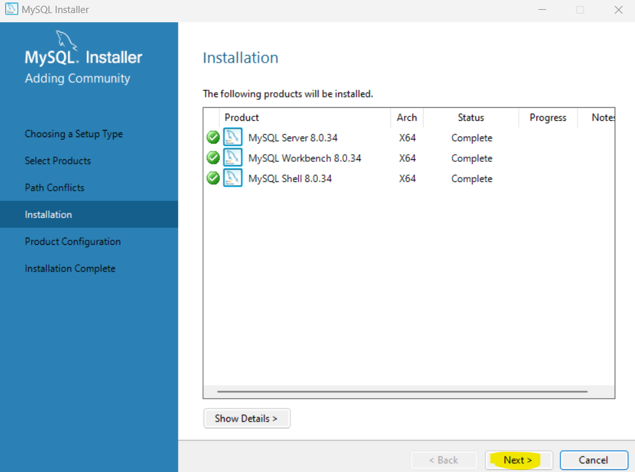

Slide 10
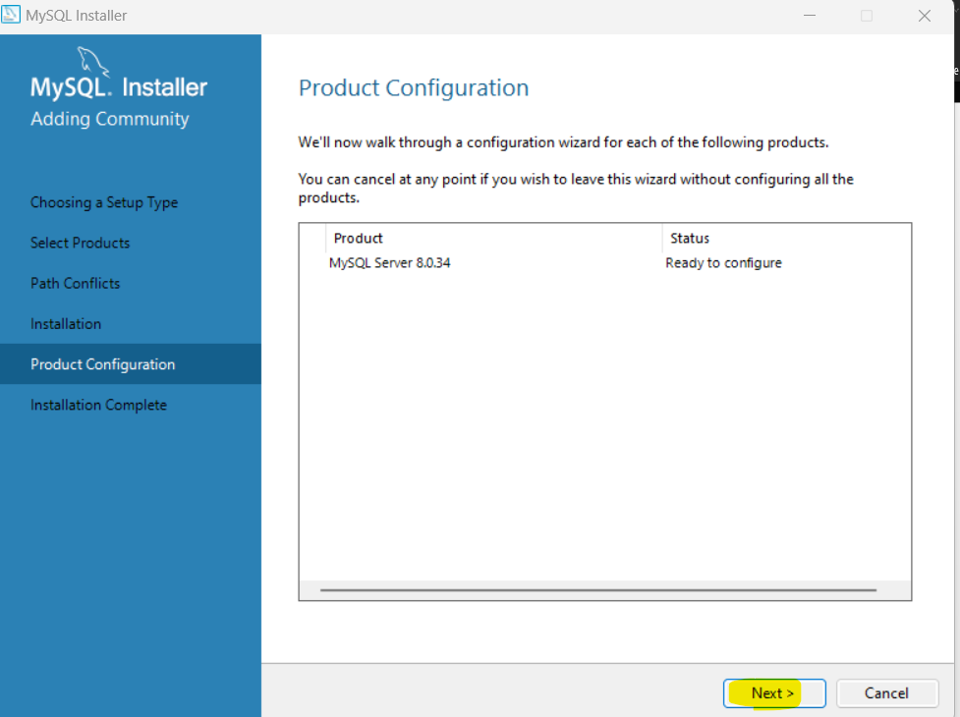

Slide 11
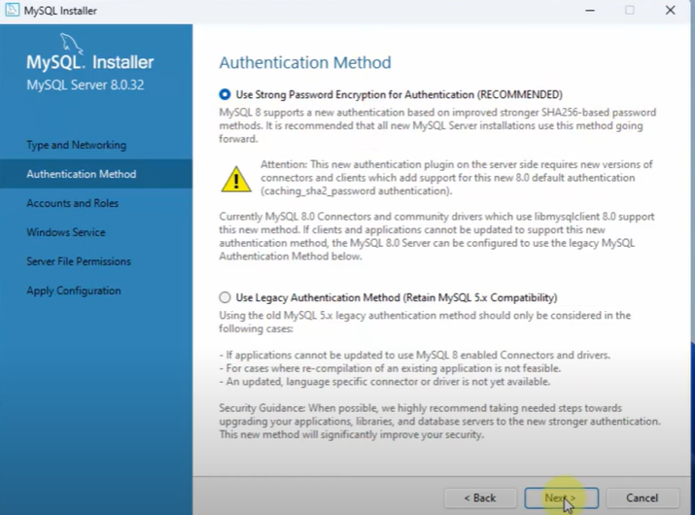
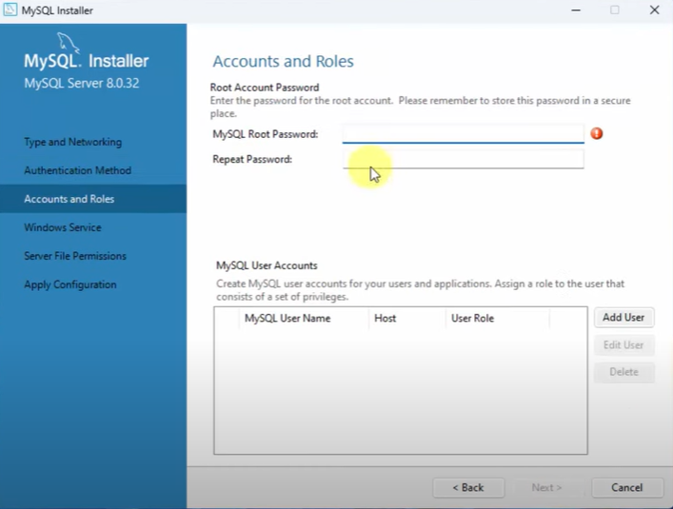
Enter a simple password , make sure you remember it and click on next.

Slide 12
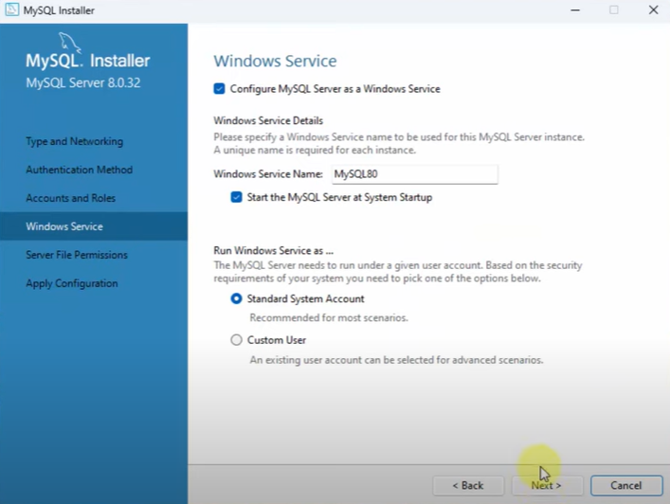
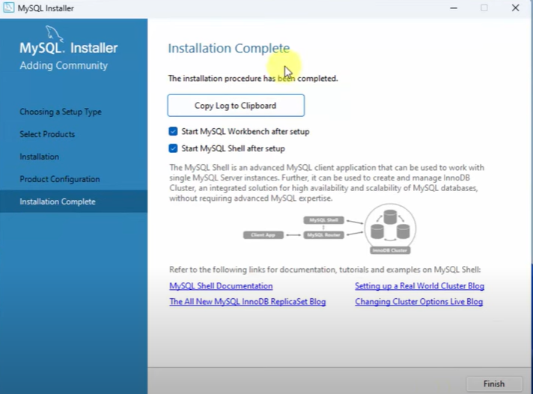
click on next and execute remaining configuration. Installation will complete

